Slide 1
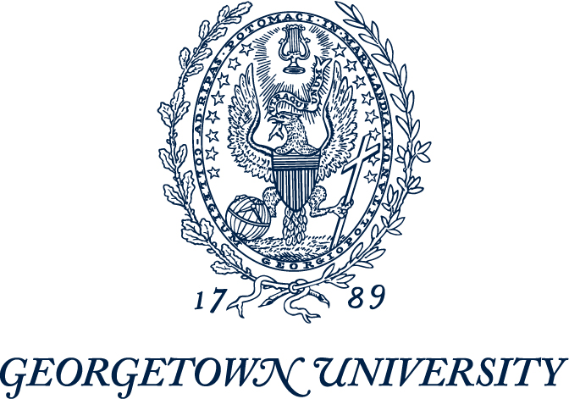
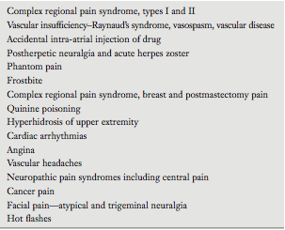
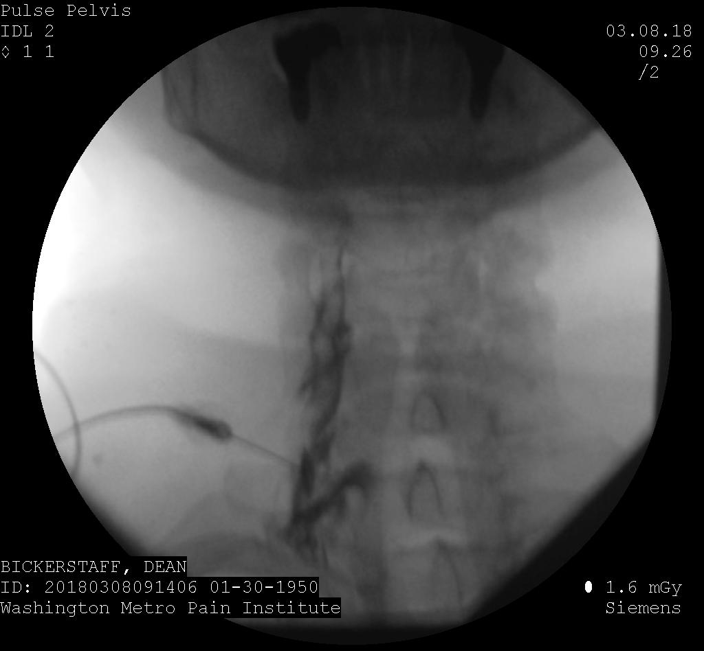
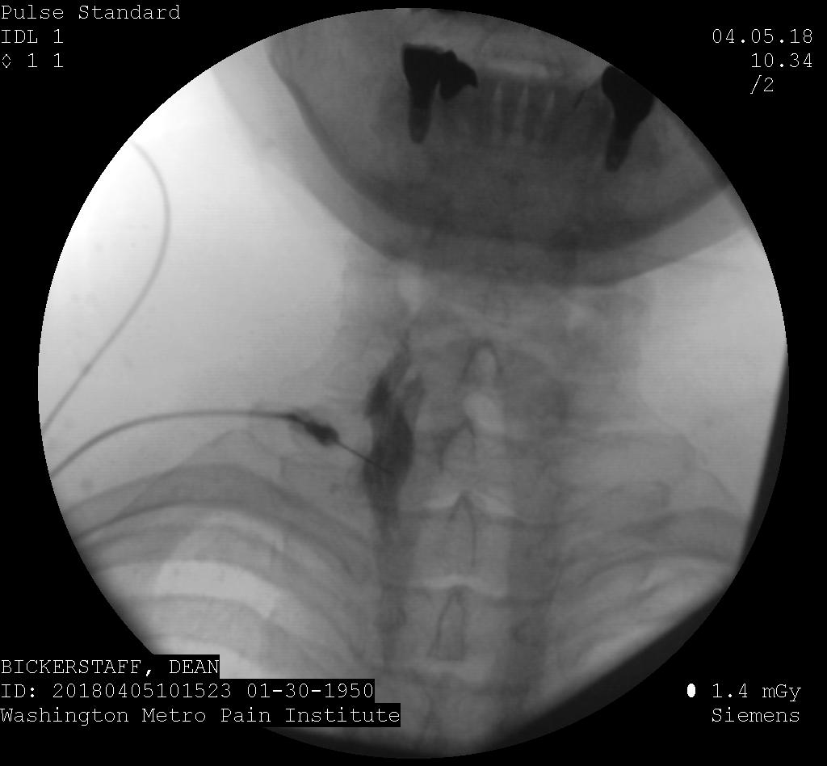
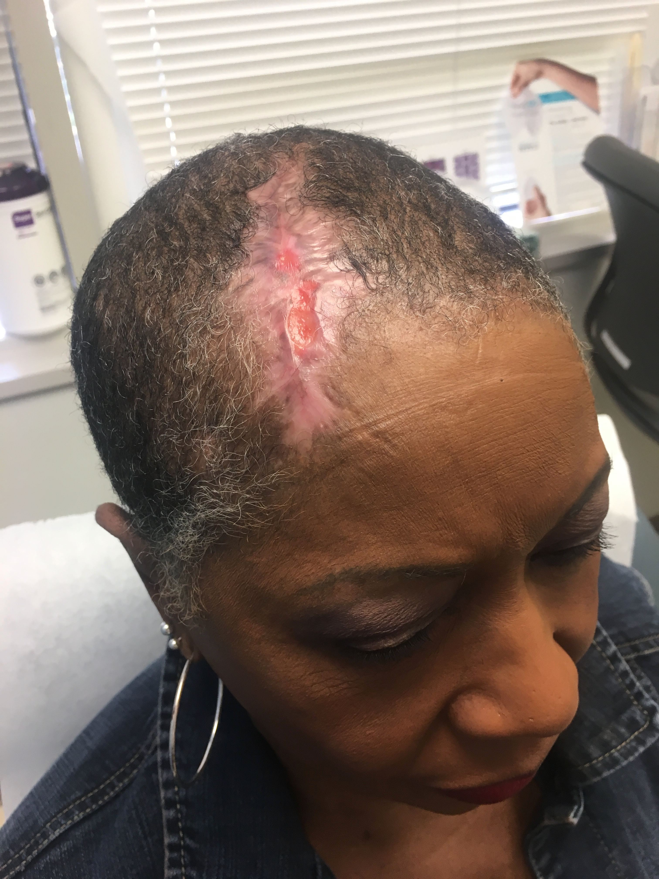
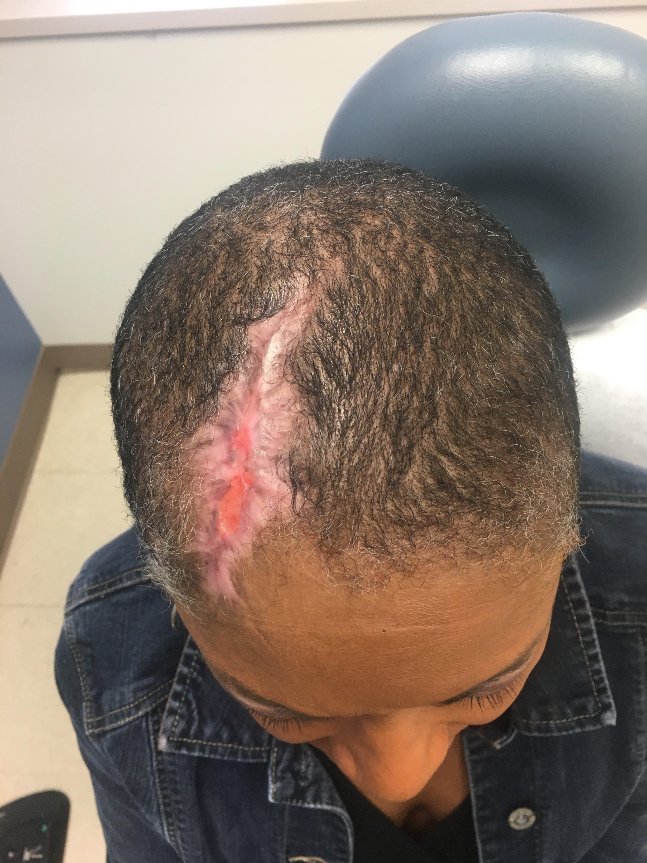
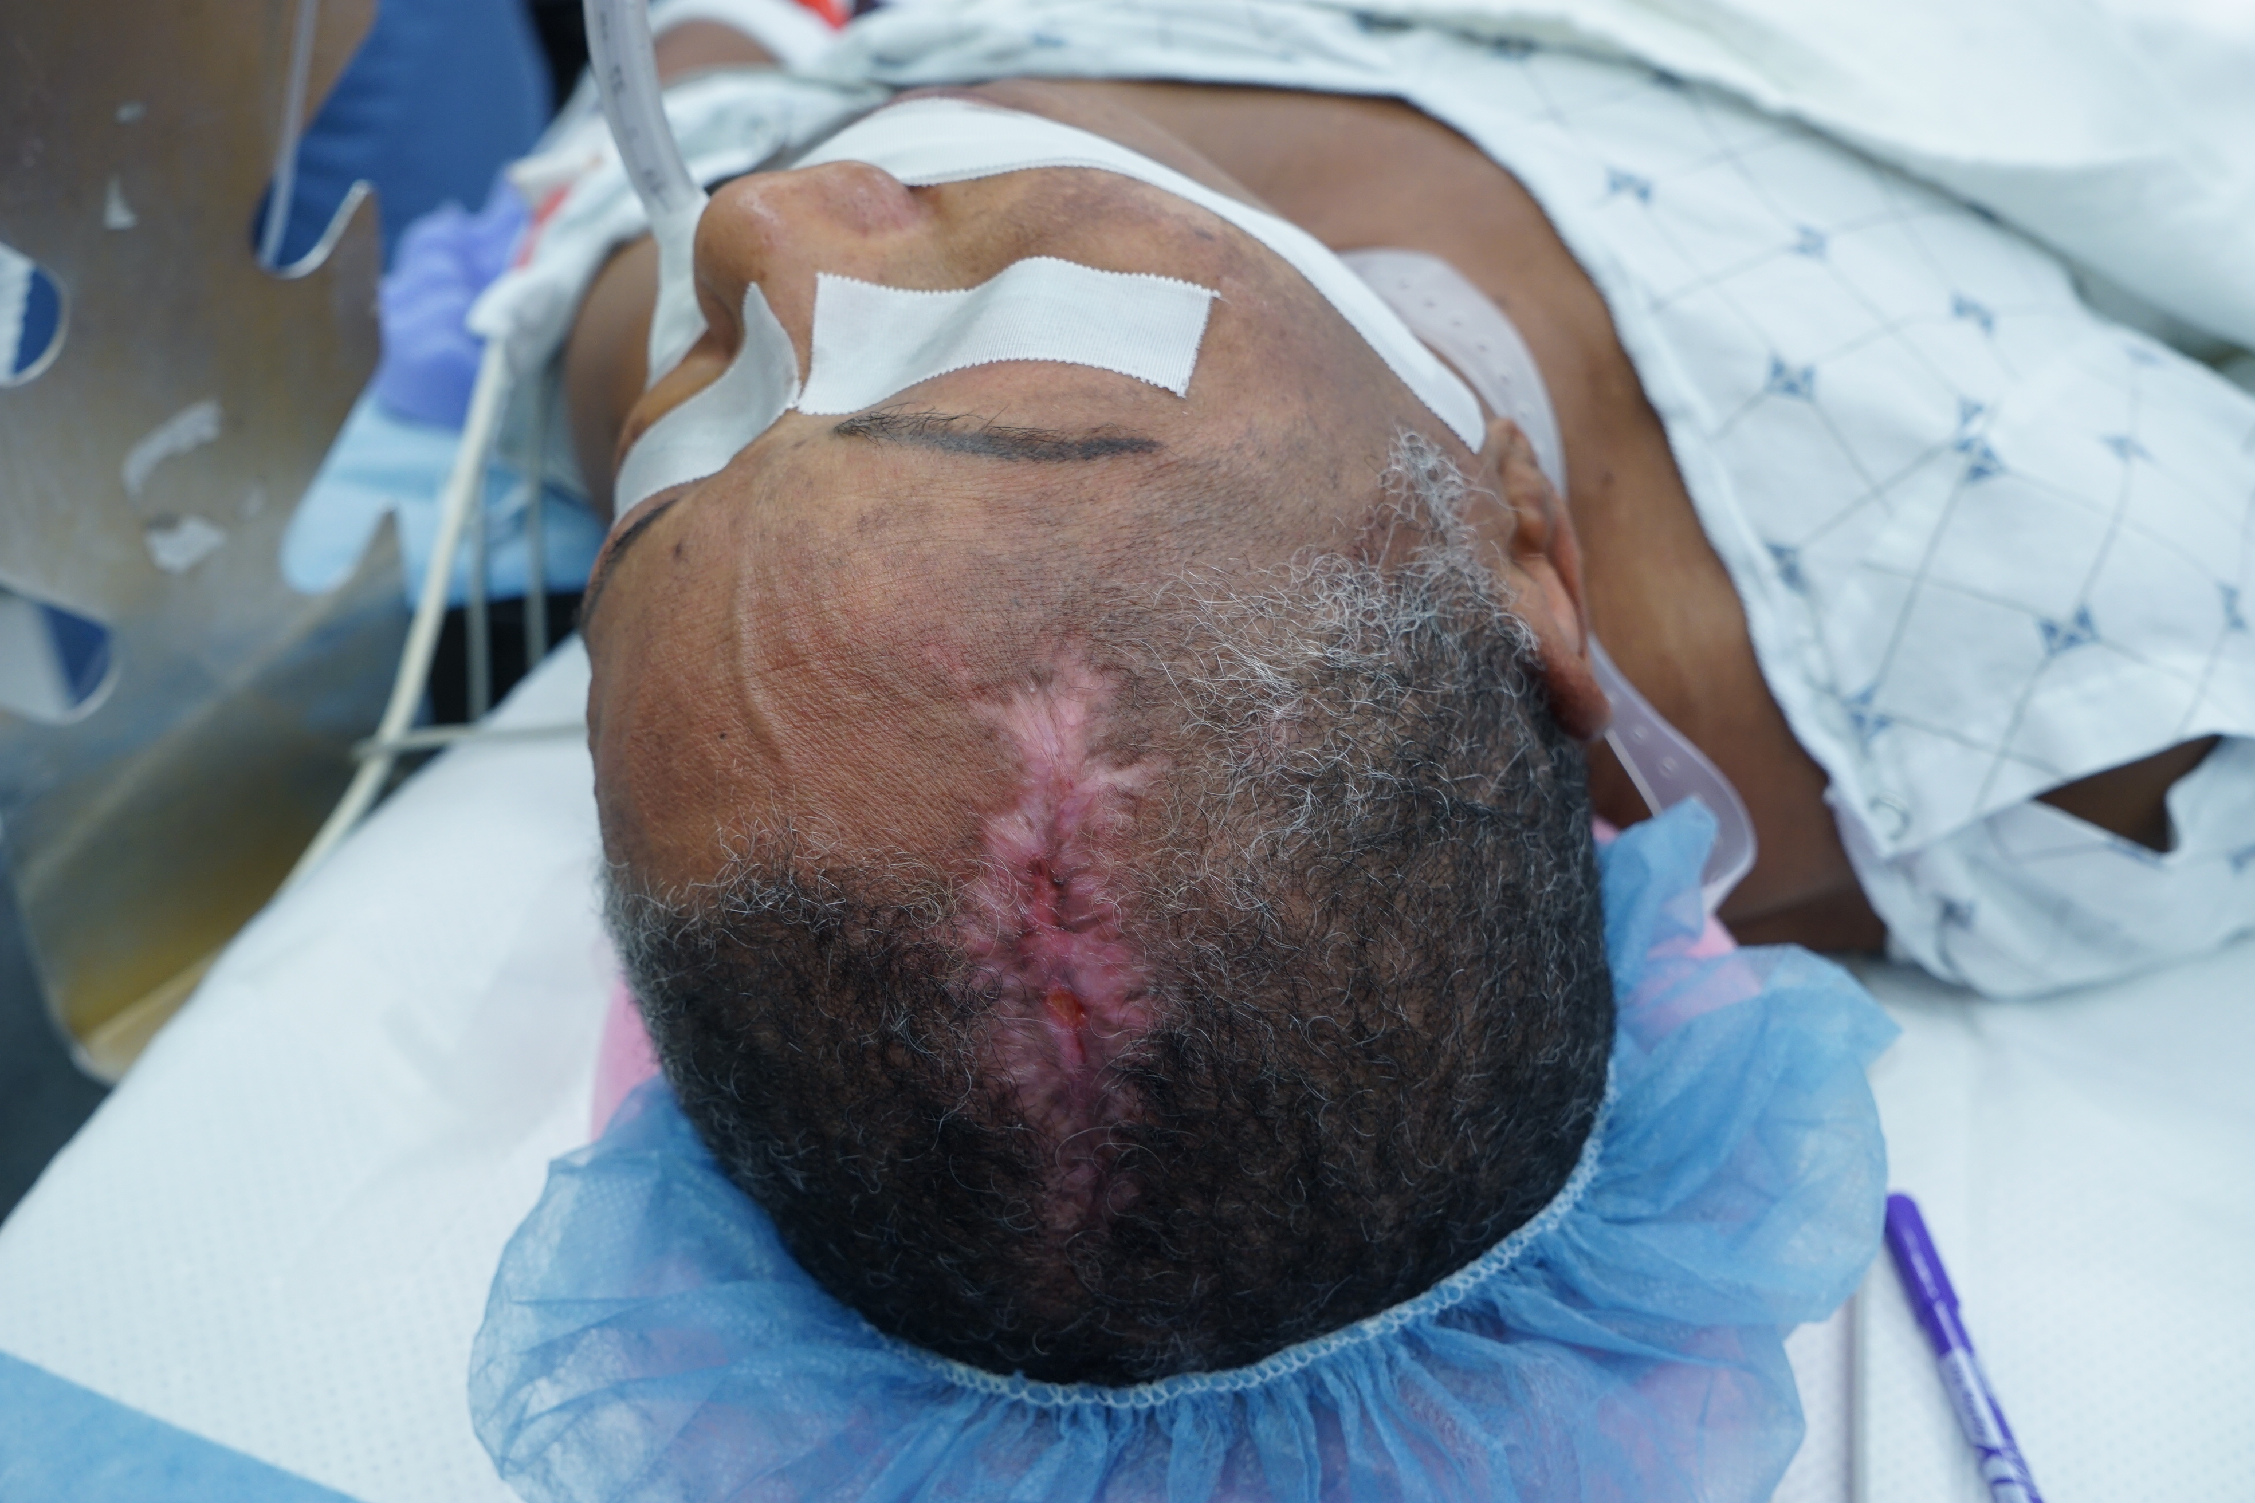
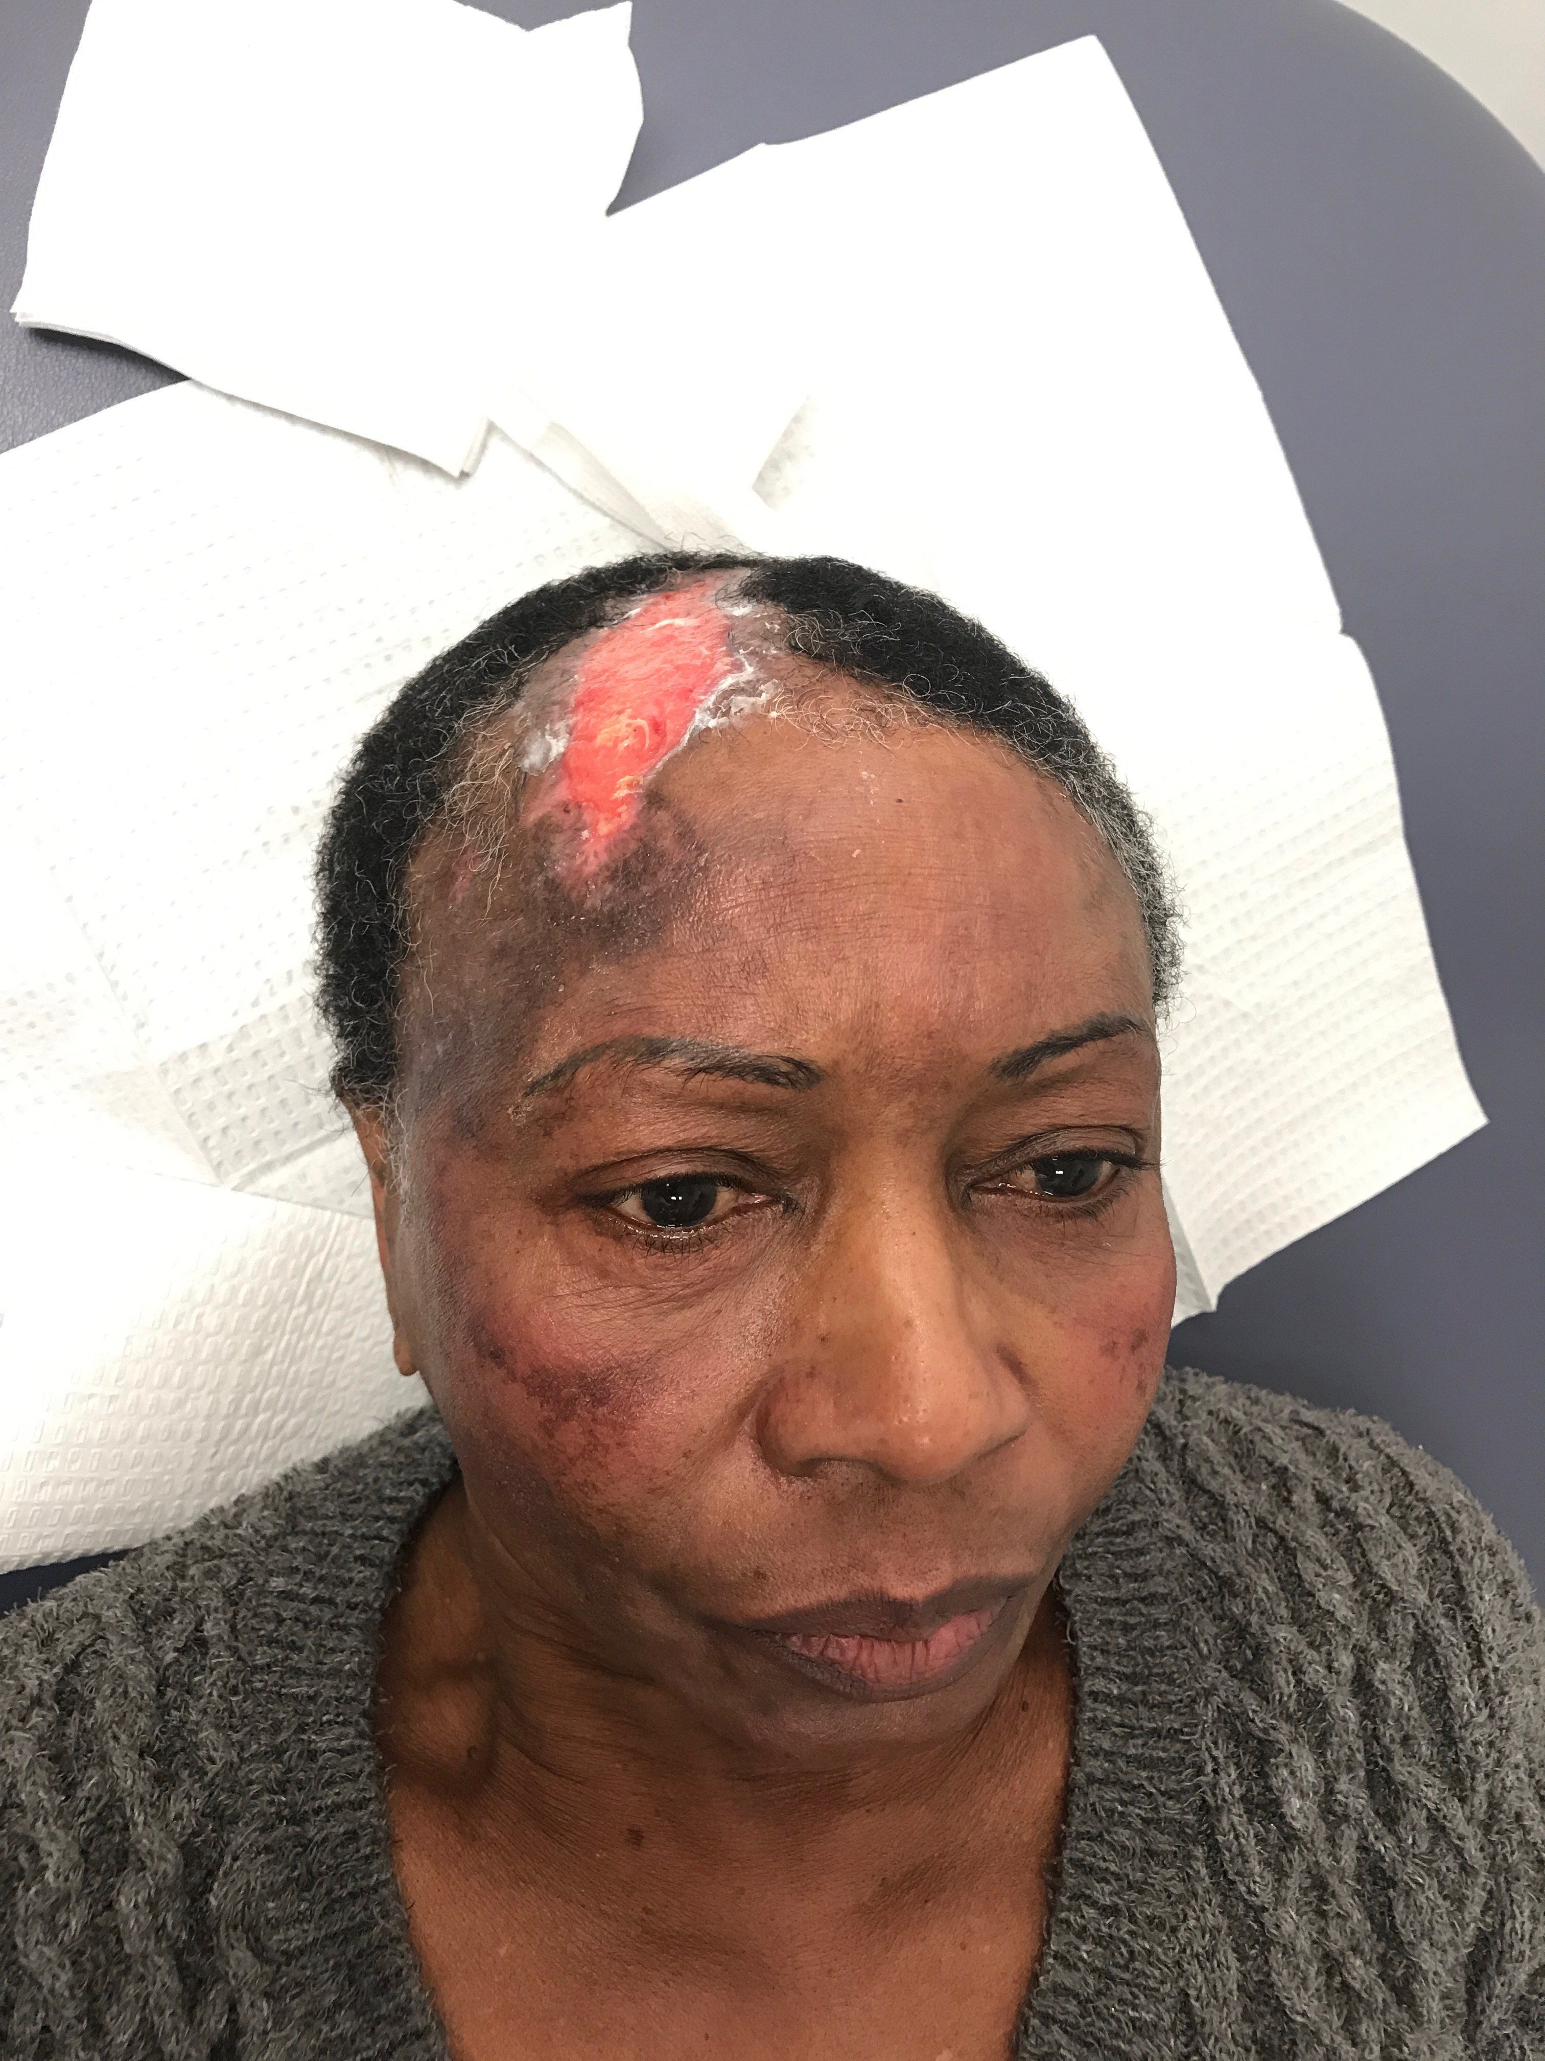
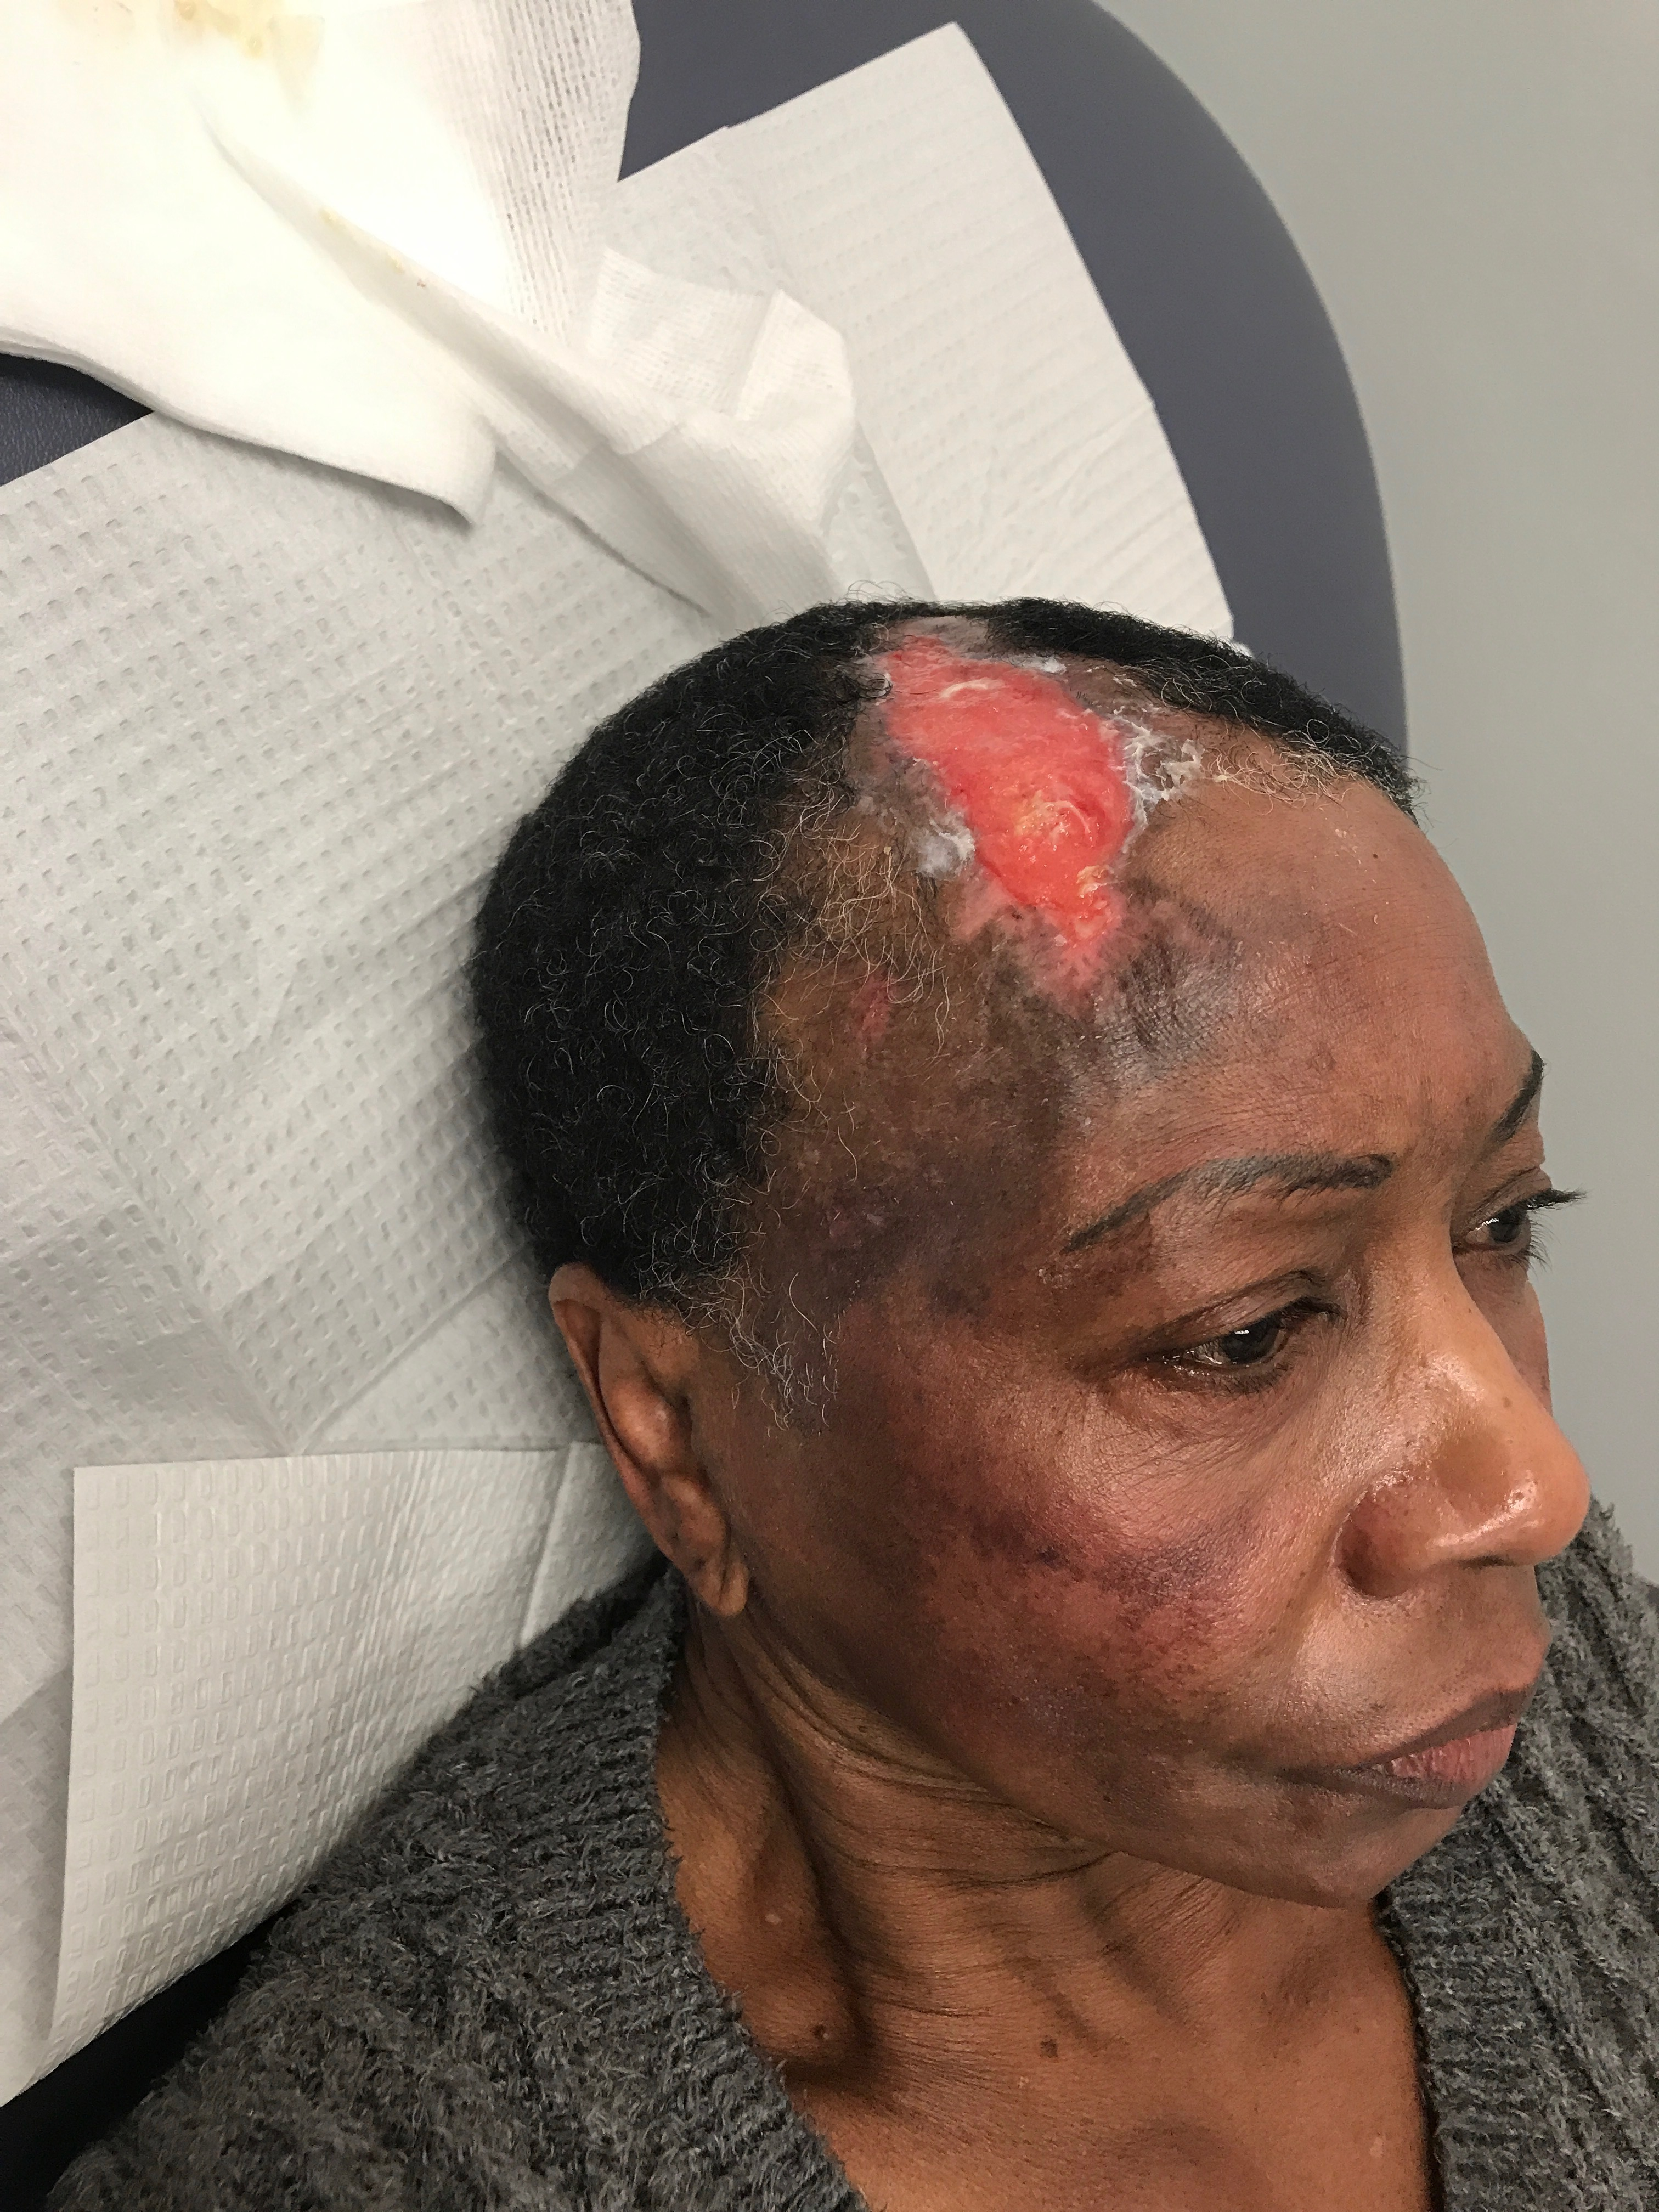
“Those Shots Went Straight to my Head”
Stellate Ganglion Block May Improve Healing After Intra-arterial Injection of Sclerosing Agent to Superficial Temporal Artery
Brent Earls MD, Alex Kieffer MD, Netsere Tesfayohannes MD
Department of Anesthesiology Medstar Georgetown University Hospital
Washington, DC
INTRODUCTION
INDICATIONS 8 WEEKS AFTER FINAL INJECTION
Varicose veins are extremely common and often treated by variety of clinical teams including vascular surgeons, dermatologists, plastic surgeons and other specialized providers¹
Many complications exist in treatment of varicosities, and while rare, arterial injection represents an event of significant morbidity
Our patient is a 68-year-old female who presented 6 weeks following an accidental arterial injection of a sclerosing agent during treatment of varicose veins around the eye
The injection resulted in immediate pain followed by erythema and edema of the scalp the next day which did not respond to a course of steroids
She was referred for hyperbaric oxygen treatments due to devitalization of the scalp over the right upper forehead in the distribution of the frontal branch of the superficial temporal artery
She continued to have pain unresponsive to acetaminophen, NSAIDs, gabapentinoids, codeine and even peripheral nerve blocks for her now 15cm full-thickness necrotic wound
Our patient was evaluated in the pain clinic, approximately 6 weeks into wound care with minimal recovery, to help relieve her associated pain
Our patient had received 4 out of 4 injections in the photos to the left
The edges of the wound bed had begun to show large areas of granulation tissue extending to the center of the wound
Pain from the wound continued to be well controlled with occasional NSAIDs
3 weeks after the above photos were taken, our patient was able to be taken to the operating room for the first stage of scar revision
The wound bed was 100% granulation tissue and overall size had reduced by about 50%
TECHNIQUE
The stellate ganglion is an oval shaped bundle of nerves formed by the fusion of the inferior cervical and 1st thoracic ganglions of the sympathetic chain²
The ganglion lies anterior to the prevertebral fascia and medial to the carotid sheath and contains most of the preganglionic fibers for the head and neck which ascend the cervical trunk to the superior cervical ganglion providing vasoconstrictor nerves to the face and neck among other functions
Various imaging modalities including ultrasound, CT, and fluoroscopy have been used to supplement the traditional blind technique in order to minimize risk and improve success rates
Approach at the C7 vertebral level allows for closer proximity to the ganglion however, the vertebral artery is uncovered at this level unlike at the C6 level where the artery courses posteriorly to Chassaignac’s tubercle
After identifying the preferred level, a needle is passed to contact the anterior transverse process then withdrawn 2mm, after negative aspiration contrast agent and local anesthetic can be infiltrated
INITIAL PRESENTATION
Presentation seen here was 4 weeks after initial injury
She had undergone 10 60-minute treatments of hyperbaric oxygen
Wound measures approximately 15cm x 5cm at its widest dimension
After being seen by the plastic surgery service, she was sent to pain management for further evaluation
There she agreed to undergo 4 stellate ganglion blocks over 4 weeks in addition to continued wound care with the plastic surgery department
CONCLUSION
The stellate ganglion block was an effective modality to treat our patient’s scalp pain related to her wound.
This block is also an effective means to increase blood flow through the superficial temporal artery³. Increased blood flow improves oxygen delivery and cellular waste removal which facilitates a healing environment required for tissue repair⁴ The use of imaging modalities improves safety and efficacy the procedure
We believe this technique could be an adjuvant therapy for wound healing of various etiology throughout the body
Disclosure: Patient images are courtesy of Dr. Grant Kleiber with Georgetown University Department of Plastic Surgery
Fluoroscopic images were taken from procedure performed on our patient
All images are used with expressed permission of our patient for this presentation
CLINICAL IMPLICATION
Larger studies are needed to investigate the clinical impact of such a treatment
Peripheral sympathectomy appears to have a significant impact on healing from impaired arterial flow due to localized clot or embolus

